Slide 1
ENG 1011
Short Story Writing
(Based on the 7 Steps to Writing Success Framework)
SAJJAD HOSSAIN

Slide 2
The Narrative Arc
A compelling short story follows a structured, gradual build-up of tension.
The core elements include:
Backfill (Introduction & Context)
Pebble (A small problem)
Brick (A medium problem)
Boulder (A major problem/climax)
Exciting Ending (Resolution)
Character Wrap-Up (Conclusion)

Slide 3


Step 1: Backfill
The backfill briefly introduces the main characters and their context to the reader.
■
Structure: Typically 1-2 sentences.
■
Purpose: Address the 5 Ws: Who? What? When? Where? Why?
Example (The Robber): "Jami and her family decided to go to the big park near the sandy beach for a picnic. They were very excited. At the park Jazelle saw tall trees and colourful flowers all around."

Slide 4
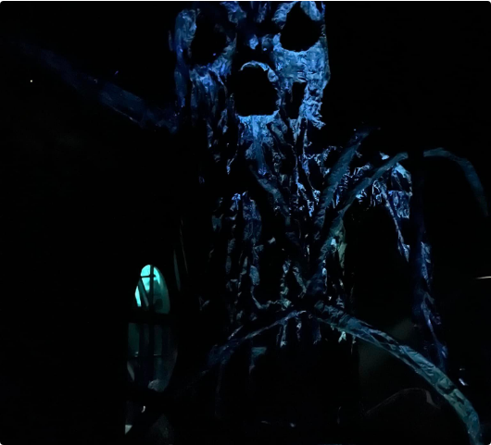
Step 2: The Pebble (Small Problem)
The tension begins to build. The setting is described, the initial problem is introduced, and secondary characters may appear.
■
Structure: Typically 2-3 sentences.
Example (The Haunted Mansion): "After eating, Jami and Sany noticed something on the ground. It was an arrow made of sticks, pointing towards the woods. They were curious. They decided to follow the arrow... The arrow led them to a strange, old mansion."

Slide 5
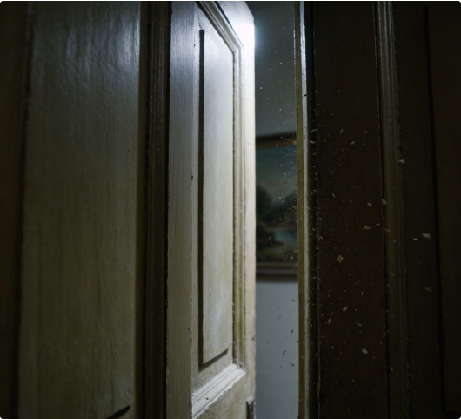
Step 3: The Brick (Medium Problem)
Things begin to go wrong for the characters. This section explains how the problem is escalating and worsening.
■
Structure: Typically 2-3 sentences.
Example (The Haunted Mansion): "They opened the creaky door and stepped inside. The house was dark and dusty. Suddenly, the door slammed shut behind them with a loud BANG!"

Slide 6

Step 4: The Boulder (Big Problem)
This is the climax of the tension—the point where the problem reaches its absolute worst.
■
Goal: The reader must think, "They will never make it!"
■
Structure: Typically 2-3 sentences.
Example (The Robber): "He broke the glass window and went inside. He opened the silver fridge, ate all the delicious food and stole all their money. The family’s brave dog spotted the robber and started barking loudly."

Slide 7
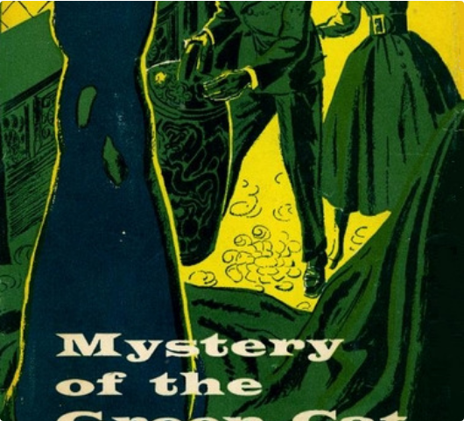
Step 5: Exciting Ending
The narrative tension breaks. The main character solves the problem, usually through a clever idea, and "saves the day."
■
Structure: Typically 1-2 sentences.
Example (The Haunted Mansion): "Instead of a ghost, they saw something even more surprising—a friendly cat! ... Jami and Sany decided to trust the cat. They followed it down the hallway, around a corner, and then to a door that led outside!"

Slide 8

Step 6: Character Wrap-Up
The story concludes with the characters reflecting on the events and internalizing a lesson.
■
Structure: Typically 1 sentence.
Example (The Haunted Mansion): "Jami and Sany nodded. They had learned a big lesson that day. The rest of the picnic was peaceful and fun, but they never forgot their scary adventure in the haunted mansion."

Slide 9
Key Narrative Elements
To maximize the impact of this structure, writers must employ specific techniques:
The 5 Senses: Use sensory details to “show, don’t tell,” particularly during the tension-building phases (Pebble, Brick, Boulder).
Consistent Tense: Maintain the use of past tense verbs throughout the narrative to ensure smooth storytelling.
Dynamic Dialogue: Incorporate examples of dialogue during the tension phases to bring the scenes and characters to life.

